Slide 1
Ionic and Metallic Bonds
8-3

Slide 2
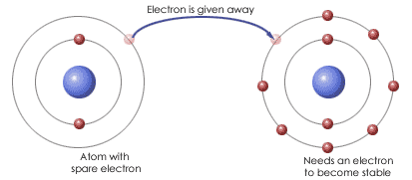
Ionic Bonds
Ionic Bond – attraction between positively and negatively charged ions
Transfer electrons
Stronger than covalent
Metal + Nonmetal

Slide 3
Ionic Bonds
Instead of sharing outer most electrons they are transferred
Na⁺ ion and Cl⁻ ion

Slide 4
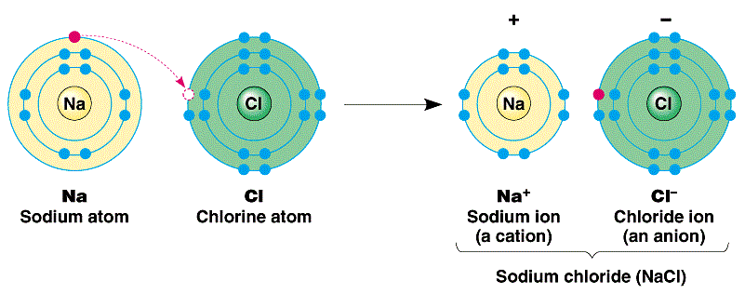
Ionic Compounds
Solid and brittle at room temperature
High melting and boiling point
Dissolve in water

Slide 5
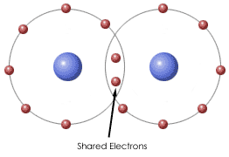
Metallic Bonds
Metallic Bond – many metal atoms share polled valence electrons
Metal and Metal

Slide 6
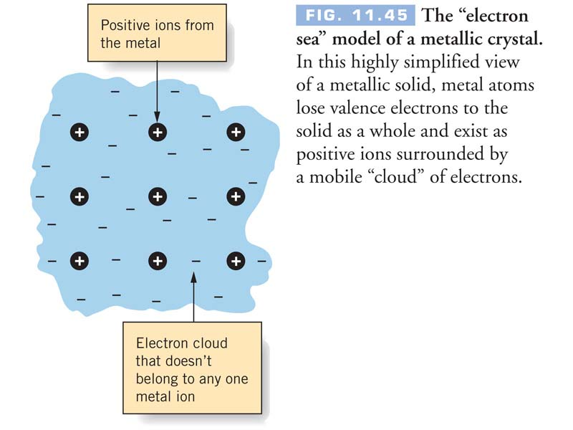
Metallic Bond
Does not break easily
Conducts electricity
Shiny – valance electrons at surface interact with light

Slide 7
